Slide 1
Modelling Problem 2 as a
Vehicle Routing Problem(VRP)

Slide 2
Agenda
Dataset curation
Assumptions and Modelling.
Scenario based evaluation (comparison with TSP)

Slide 3
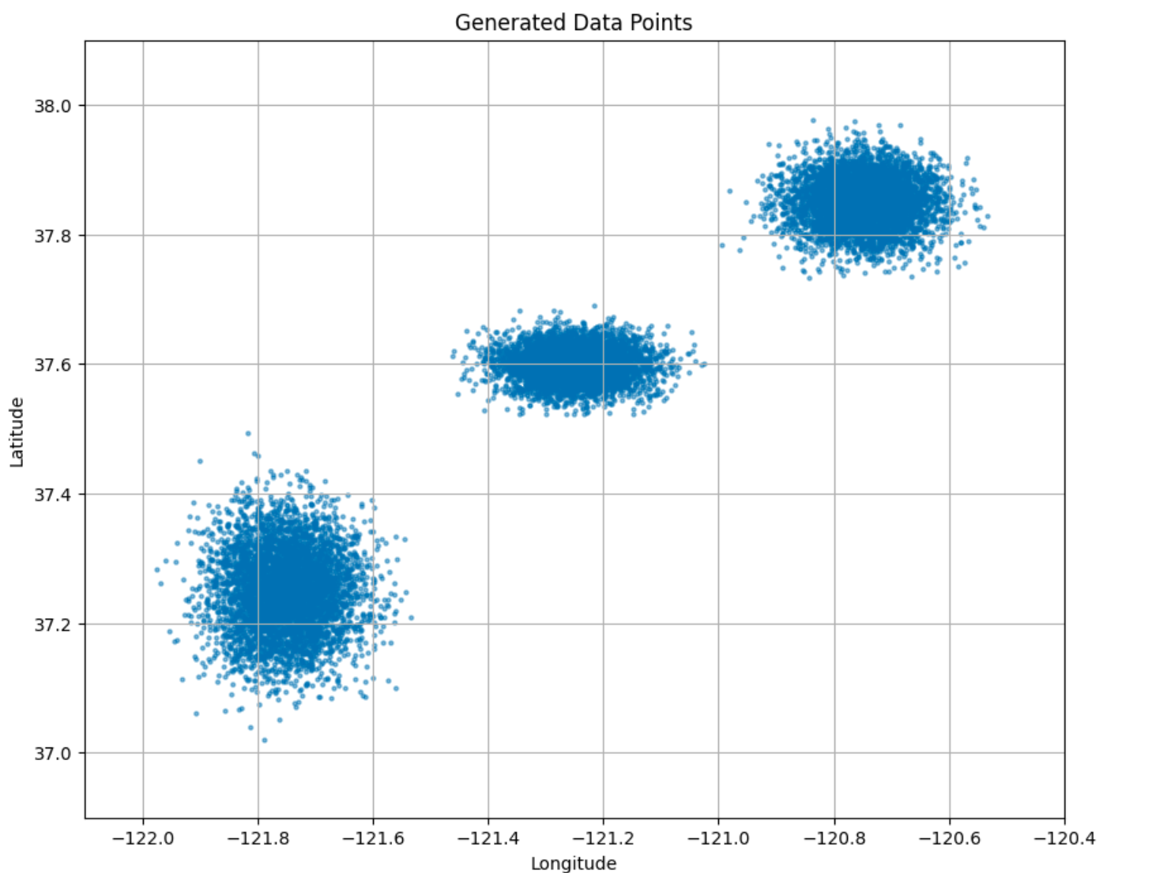
Dataset Curation
Data points are generated using probability distributions given a max min value.
The plot goes like this:

Slide 4
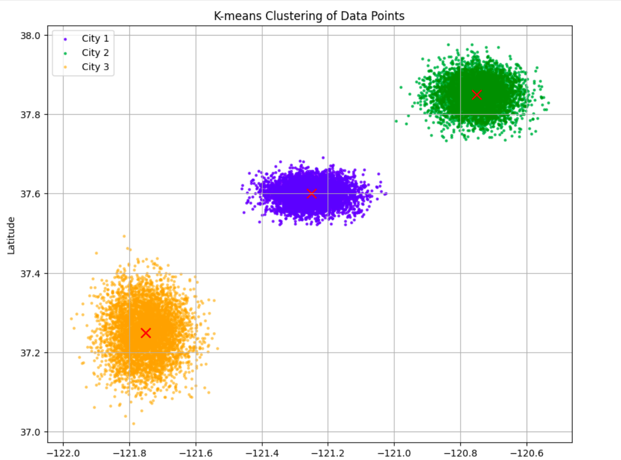
Dataset Curation
Using K Means Clustering to cluster the data and model the clusters into cities .

Slide 5
Dataset Curation
The dataset is written into CSV files and saved.
Each dataset can be opened and be processed and fed to a VRP solver.
The Centroid of the clusters is assumed to be the Depot of the VRP.

Slide 6
Assumptions and Modelling
The distance matrix of the geospatial (lat, long) data is calculated using the Haversine formula, which calculates the distance between two geospatial points.

Slide 7
Assumptions and Modelling
Food orders of the customers are also randomly generated in a restricted manner. Thresholding max orders and also accounting to no orders.
For, CVRP - Capacitated VRP the demand (orders) of each person is calculated from the orders dataset, and each vehicle can handle upto 5 orders (assumption of capacity).
For, VRPPD - Pickup and Delivery, some of the data points are assumed to be cloud kitchen centers for which the orders are present in the orders dataset from which the mapping of kitchen->customer is found.

Slide 8
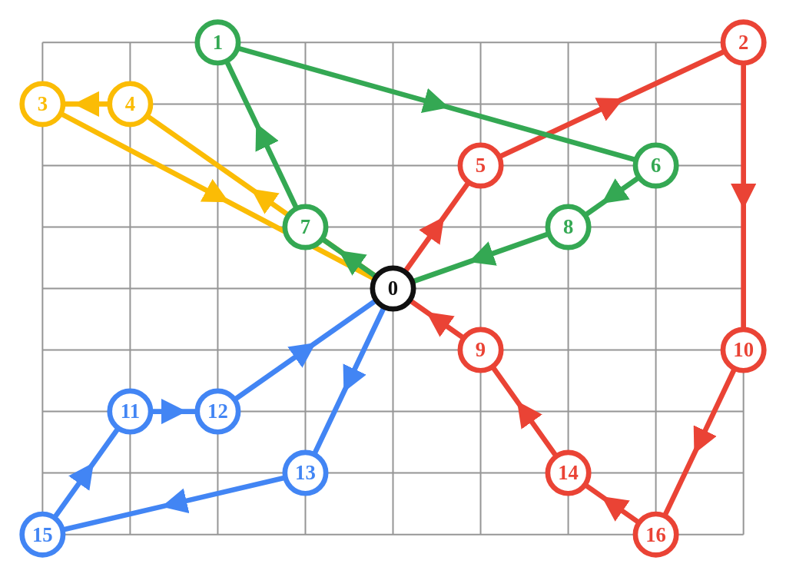
Assumptions and Modelling
Sample VRP graph for example,
Ref : https://developers.google.com/optimization/routing/pickup_delivery

Slide 9
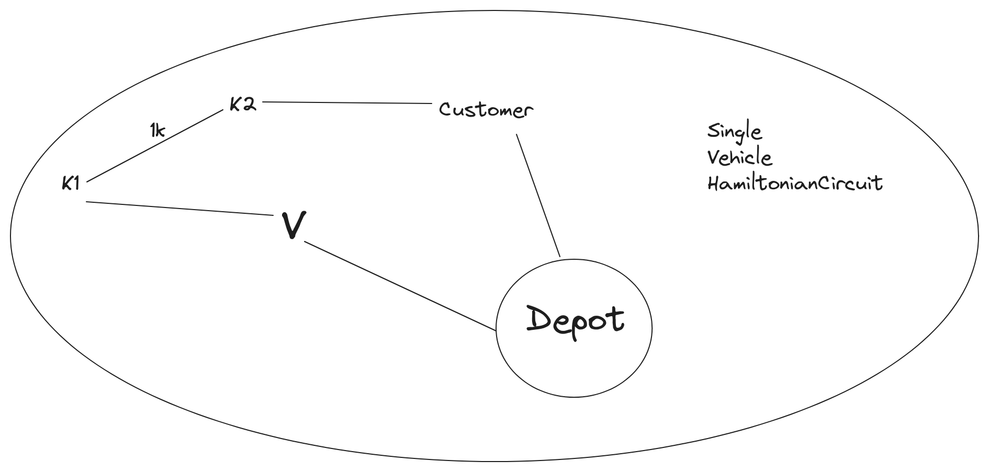
Scenario Based evaluation (TSP model for individual scenario)
Each scenario can be modelled as a individual TSP.
For example, Let's consider Scenario 1

